Slide 1


READING BOOKS

Slide 2
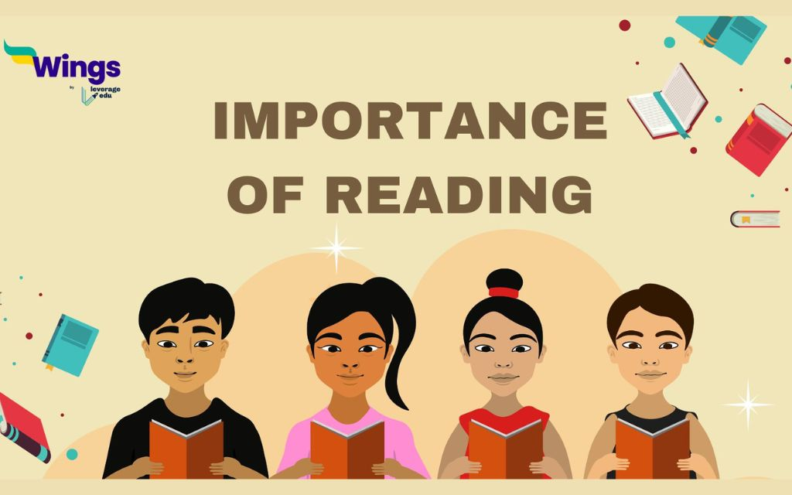
IMPORTANCE OF READING
EDUCATES YOU
KEEP YOUR BRAIN HEALTHY
MOTIVATE AND INSPIRE YOU
REDUCES STRESS AND ANXIETY

Slide 3


BOOKS READING TIPS
FOCUS ON THE INTERACTION
RELATE TO PERSNOL EXPERIENCES
MAKE IT FUN
POINT TO EACH WORD AS YOU READ

Slide 4
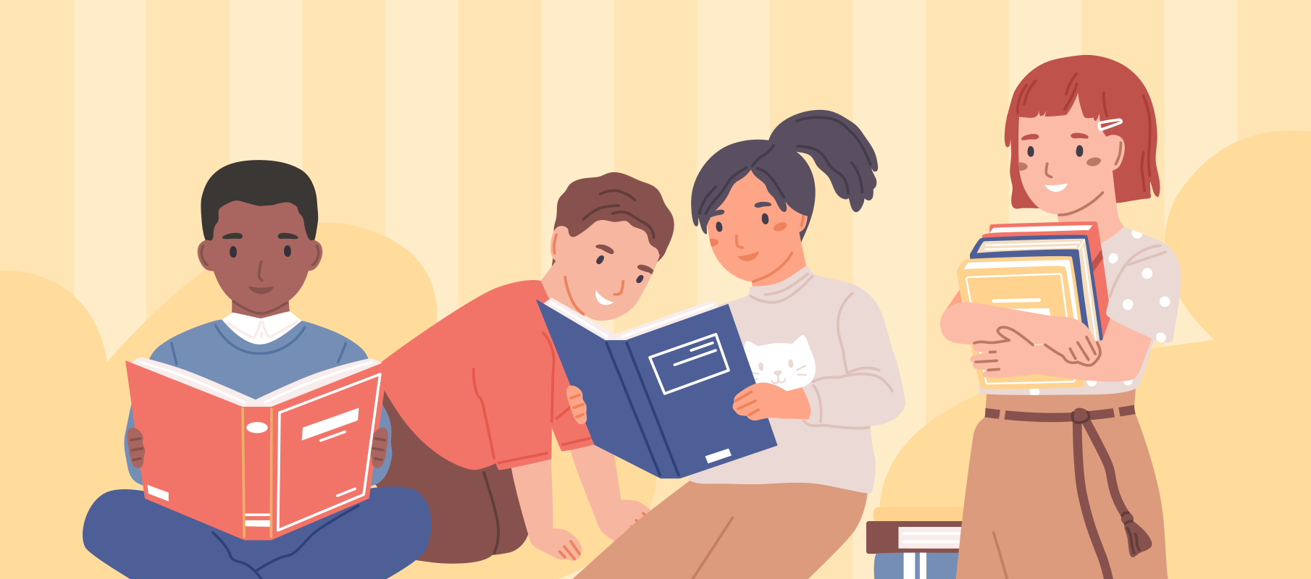
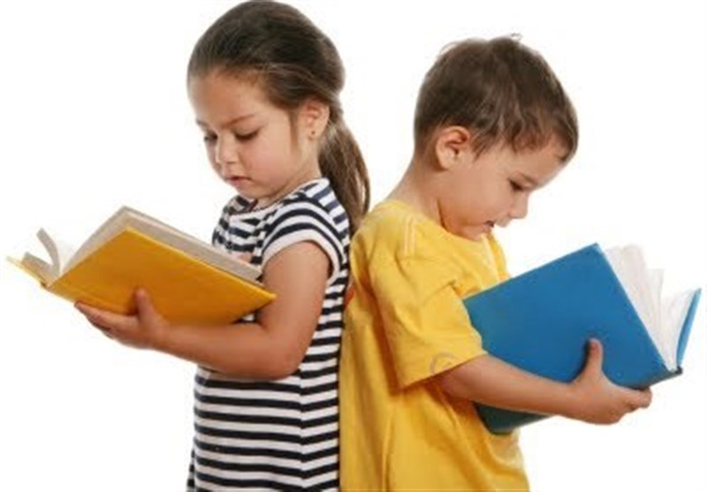
HOW TO HELP YOUR CHILD FIND A JUST RIGHT BOOK
R
What is your READER into right now? Hobbies? Favorite movies? Video games? Travels? Seek books that match their interests.
E
EXPLORE the summary, side flaps, flip through the pictures, read the first few pages.
A
ASK friends, family, or a librarians for suggestions. Look to favorite authors, characters, and genres.
D
Let the leader DECIDE which books they’ll read. DON’T let ability stand in their way. Audiobooks and reading to a child encourage reading too!

Slide 5
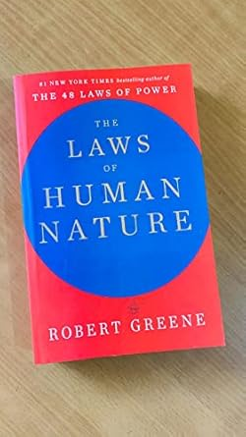

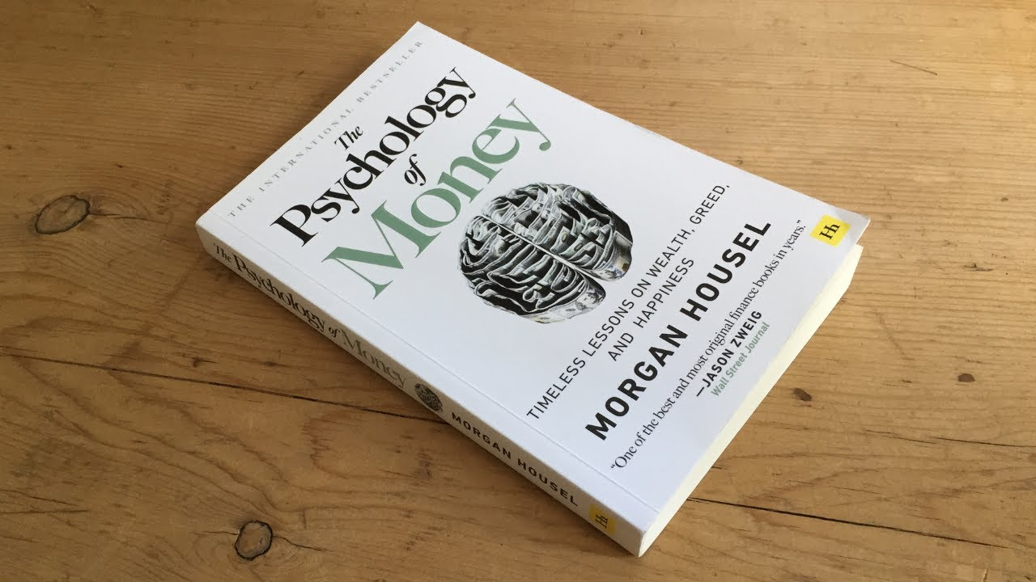

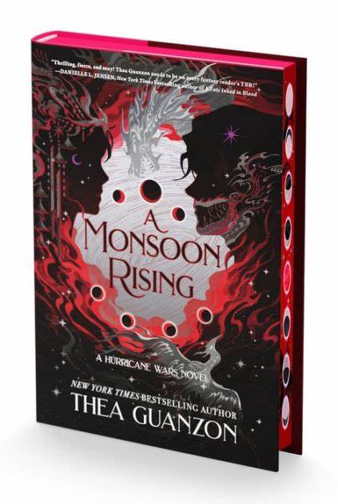


Slide 6
BENEFITS OF READING BOOKS
Sharpens brain
Builds critical mind
Betters writing skills

